Slide 1
Data Mining
Classification: Alternative Techniques
Bayesian Classifiers
Introduction to Data Mining, 2nd Edition
by
Tan, Steinbach, Karpatne, Kumar

Slide 2
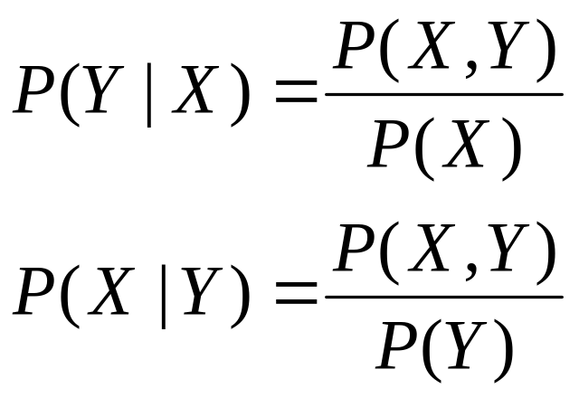
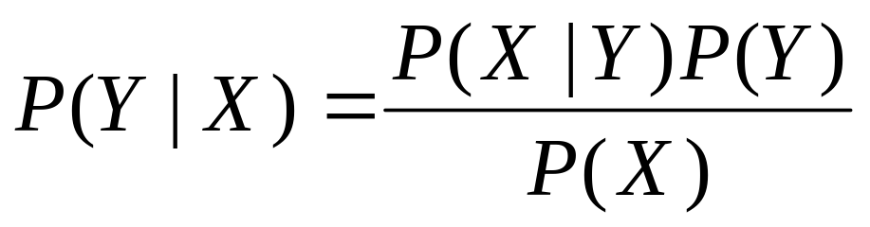
Bayes Classifier
A probabilistic framework for solving classification problems
Conditional Probability:
Bayes theorem:

Slide 3
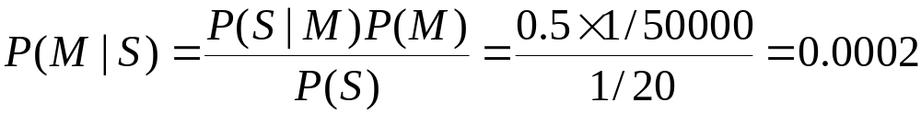
Example of Bayes Theorem
Given:
  A doctor knows that meningitis causes stiff neck 50% of the time
  Prior probability of any patient having meningitis is 1/50,000
  Prior probability of any patient having stiff neck is 1/20
If a patient has stiff neck, what’s the probability he/she has meningitis?

Slide 4
Using Bayes Theorem for Classification
Consider each attribute and class label as random variables
Given a record with attributes (X₁, X₂,…, X_{d})
  Goal is to predict class Y
  Specifically, we want to find the value of Y that maximizes P(Y| X₁, X₂,…, X_{d} )
Can we estimate P(Y| X₁, X₂,…, X_{d} ) directly from data?

Slide 5
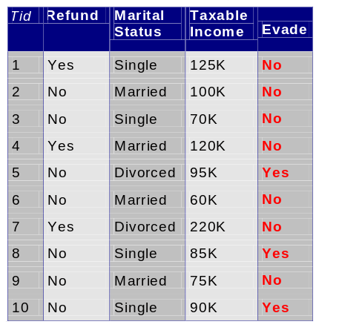
Example Data
Given a Test Record:
Can we estimate
  P(Evade = Yes | X) and P(Evade = No | X)?
  In the following we will replace
  Evade = Yes by Yes, and
  Evade = No by No

Slide 6
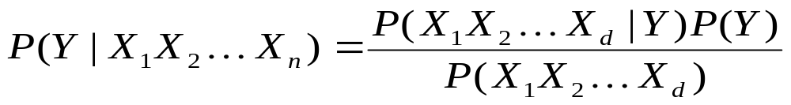
Using Bayes Theorem for Classification
Approach:
  compute posterior probability P(Y | X₁, X₂, …, X_{d}) using the Bayes theorem
  Maximum a-posteriori: Choose Y that maximizes
  P(Y | X₁, X₂, …, X_{d})
  Equivalent to choosing value of Y that maximizes
  P(X₁, X₂, …, X_{d}|Y) P(Y)
How to estimate P(X₁, X₂, …, X_{d} | Y )?

Slide 7
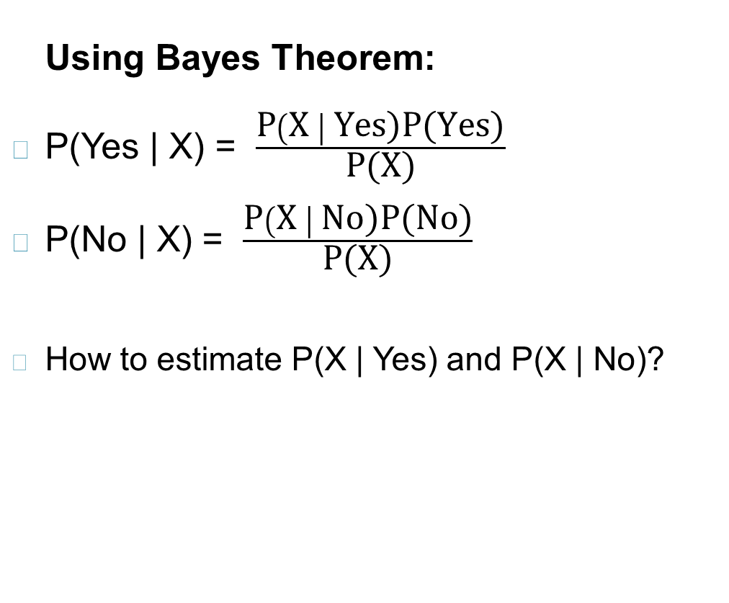
Example Data
Given a Test Record:

Slide 8
Naïve Bayes Classifier
Assume independence among attributes X_{i} when class is given:
  P(X₁, X₂, …, X_{d} |Y_{j}) = P(X₁| Y_{j}) P(X₂| Y_{j})… P(X_{d}| Y_{j})
  Now we can estimate P(X_{i}| Y_{j}) for all X_{i} and Y_{j} combinations from the training data
  New point is classified to Y_{j} if P(Y_{j}) Π P(X_{i}| Y_{j}) is maximal.

Slide 9
Conditional Independence
X and Y are conditionally independent given Z if P(X|YZ) = P(X|Z)
Example: Arm length and reading skills
  Young child has shorter arm length and limited reading skills, compared to adults
  If age is fixed, no apparent relationship between arm length and reading skills
  Arm length and reading skills are conditionally independent given age

Slide 10
Naïve Bayes on Example Data
Given a Test Record:
  P(X | Yes) =
  P(Refund = No | Yes) x
  P(Divorced | Yes) x
  P(Income = 120K | Yes)
  P(X | No) =
  P(Refund = No | No) x
  P(Divorced | No) x
  P(Income = 120K | No)

Slide 11
Estimate Probabilities from Data
Class: P(Y) = N_{c}/N
  e.g., P(No) = 7/10,
  P(Yes) = 3/10
For categorical attributes:
P(X_{i} | Y_{k}) = |X_{ik}|/ N_{c}
  where |X_{ik}| is number of instances having attribute value X_{i} and belonging to class Y_{k}
  Examples:
  P(Status=Married|No) = 4/7
  P(Refund=Yes|Yes)=0
k

Slide 12
Estimate Probabilities from Data
For continuous attributes:
  Discretization: Partition the range into bins:
    Replace continuous value with bin value
      Attribute changed from continuous to ordinal
  Probability density estimation:
    Assume attribute follows a normal distribution
    Use data to estimate parameters of distribution
    (e.g., mean and standard deviation)
    Once probability distribution is known, use it to estimate the conditional probability P(X_{i}|Y)
k

Slide 13
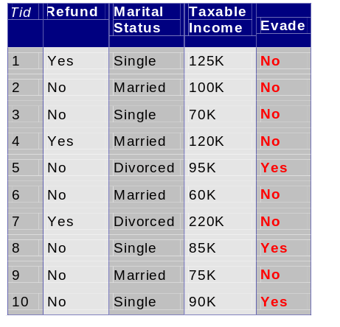
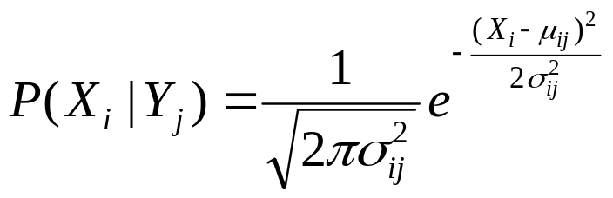
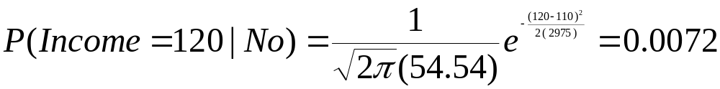
Estimate Probabilities from Data
Normal distribution:
  One for each (X_{i},Y_{i}) pair
For (Income, Class=No):
  If Class=No
    sample mean = 110
    sample variance = 2975

Slide 14
Example of Naïve Bayes Classifier
Given a Test Record:
Naïve Bayes Classifier:
P(Refund = Yes | No) = 3/7
P(Refund = No | No) = 4/7
P(Refund = Yes | Yes) = 0
P(Refund = No | Yes) = 1
P(Marital Status = Single | No) = 2/7
P(Marital Status = Divorced | No) = 1/7
P(Marital Status = Married | No) = 4/7
P(Marital Status = Single | Yes) = 2/3
P(Marital Status = Divorced | Yes) = 1/3
P(Marital Status = Married | Yes) = 0
For Taxable Income:
If class = No: sample mean = 110
sample variance = 2975
If class = Yes: sample mean = 90
sample variance = 25
P(X | No) = P(Refund=No | No)
× P(Divorced | No)
× P(Income=120K | No)
= 4/7 × 1/7 × 0.0072 = 0.0006
P(X | Yes) = P(Refund=No | Yes)
× P(Divorced | Yes)
× P(Income=120K | Yes)
= 1 × 1/3 × 1.2 × 10⁻⁹ = 4 × 10⁻¹⁰
Since P(X|No)P(No) > P(X|Yes)P(Yes)
Therefore P(No|X) > P(Yes|X)
=> Class = No

Slide 15
Example of Naïve Bayes Classifier
Given a Test Record:
Naïve Bayes Classifier:
P(Refund = Yes | No) = 3/7
P(Refund = No | No) = 4/7
P(Refund = Yes | Yes) = 0
P(Refund = No | Yes) = 1
P(Marital Status = Single | No) = 2/7
P(Marital Status = Divorced | No) = 1/7
P(Marital Status = Married | No) = 4/7
P(Marital Status = Single | Yes) = 2/3
P(Marital Status = Divorced | Yes) = 1/3
P(Marital Status = Married | Yes) = 0
For Taxable Income:
If class = No: sample mean = 110
sample variance = 2975
If class = Yes: sample mean = 90
sample variance = 25
P(Yes) = 3/10
P(No) = 7/10
P(Yes | Divorced) = 1/3 x 3/10 / P(Divorced)
P(No | Divorced) = 1/7 x 7/10 / P(Divorced)
P(Yes | Refund = No, Divorced) = 1 x 1/3 x 3/10 / P(Divorced, Refund = No)
P(No | Refund = No, Divorced) = 4/7 x 1/7 x 7/10 / P(Divorced, Refund = No)

Slide 16
Issues with Naïve Bayes Classifier
Naïve Bayes Classifier:
P(Refund = Yes | No) = 3/7
P(Refund = No | No) = 4/7
P(Refund = Yes | Yes) = 0
P(Refund = No | Yes) = 1
P(Marital Status = Single | No) = 2/7
P(Marital Status = Divorced | No) = 1/7
P(Marital Status = Married | No) = 4/7
P(Marital Status = Single | Yes) = 2/3
P(Marital Status = Divorced | Yes) = 1/3
P(Marital Status = Married | Yes) = 0
For Taxable Income:
If class = No: sample mean = 110
sample variance = 2975
If class = Yes: sample mean = 90
sample variance = 25
P(Yes) = 3/10
P(No) = 7/10
P(Yes | Married) = 0 x 3/10 / P(Married)
P(No | Married) = 4/7 x 7/10 / P(Married)

Slide 17
Issues with Naïve Bayes Classifier
Consider the table with Tid = 7 deleted
Naïve Bayes Classifier:
P(Refund = Yes | No) = 2/6
P(Refund = No | No) = 4/6
P(Refund = Yes | Yes) = 0
P(Refund = No | Yes) = 1
P(Marital Status = Single | No) = 2/6
P(Marital Status = Divorced | No) = 0
P(Marital Status = Married | No) = 4/6
P(Marital Status = Single | Yes) = 2/3
P(Marital Status = Divorced | Yes) = 1/3
P(Marital Status = Married | Yes) = 0/3
For Taxable Income:
If class = No: sample mean = 91
sample variance = 685
If class = No: sample mean = 90
sample variance = 25
Given X = (Refund = Yes, Divorced, 120K)
P(X | No) = 2/6 X 0 X 0.0083 = 0
P(X | Yes) = 0 X 1/3 X 1.2 X 10⁻⁹ = 0
Naïve Bayes will not be able to classify X as Yes or No!

Slide 18
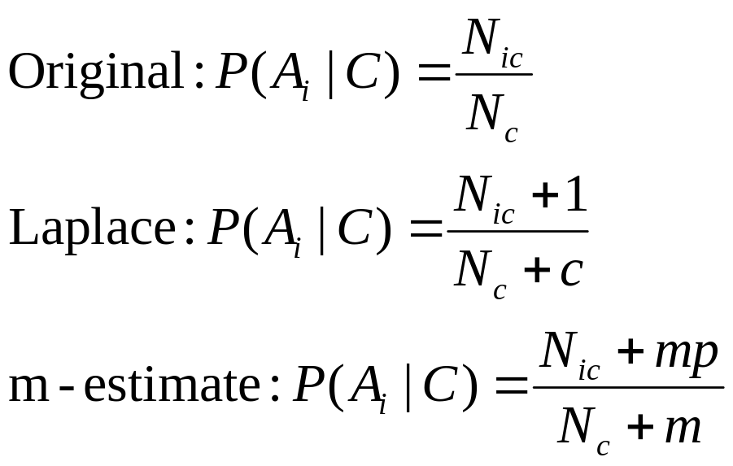
Issues with Naïve Bayes Classifier
If one of the conditional probabilities is zero, then the entire expression becomes zero
Need to use other estimates of conditional probabilities than simple fractions
Probability estimation:
c: number of classes
p: prior probability of the class
m: parameter
N_{c}: number of instances in the class
N_{ic}: number of instances having attribute value A_{i} in class c

Slide 19
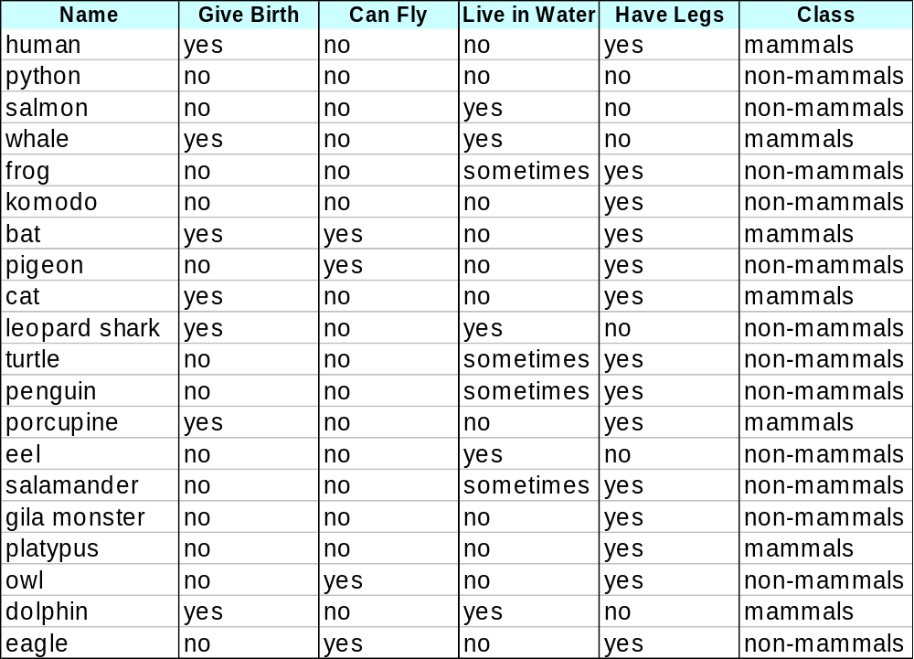
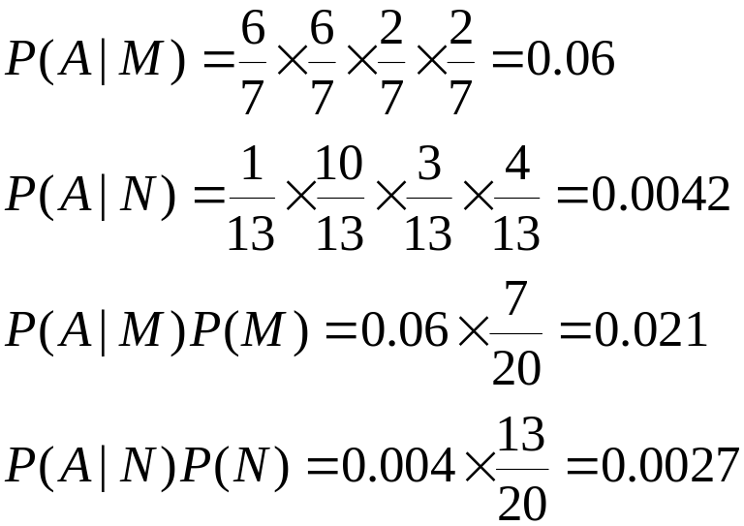
Example of Naïve Bayes Classifier
A: attributes
M: mammals
N: non-mammals
P(A|M)P(M) > P(A|N)P(N)
=> Mammals

Slide 20
Naïve Bayes (Summary)
Robust to isolated noise points
Handle missing values by ignoring the instance during probability estimate calculations
Robust to irrelevant attributes
Independence assumption may not hold for some attributes
  Use other techniques such as Bayesian Belief Networks (BBN)

Slide 21
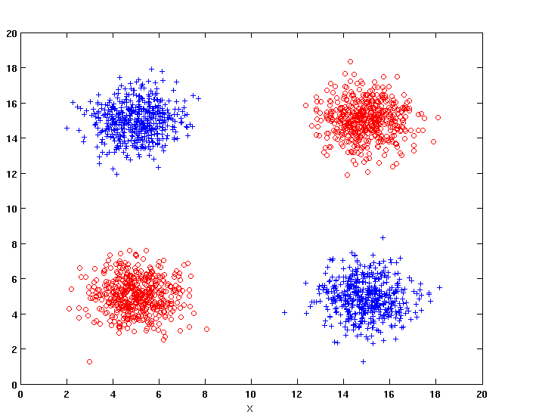
Naïve Bayes
How does Naïve Bayes perform on the following dataset?
Conditional independence of attributes is violated

Slide 22
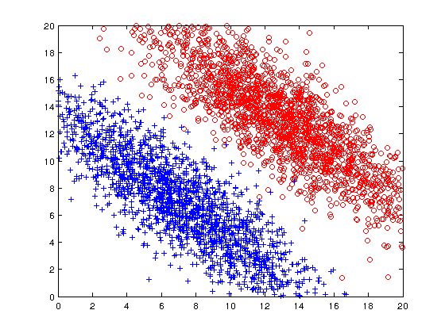
Naïve Bayes
How does Naïve Bayes perform on the following dataset?
Naïve Bayes can construct oblique decision boundaries

Slide 23
Naïve Bayes
How does Naïve Bayes perform on the following dataset?
Y = 1 | 1 | 1 | 1 | 0
Y = 2 | 0 | 1 | 0 | 0
Y = 3 | 0 | 0 | 1 | 1
Y = 4 | 0 | 0 | 1 | 1
 | X = 1 | X = 2 | X = 3 | X = 4
Y = 1 | 1 | 1 | 1 | 0
Y = 2 | 0 | 1 | 0 | 0
Y = 3 | 0 | 0 | 1 | 1
Y = 4 | 0 | 0 | 1 | 1
 | X = 1 | X = 2 | X = 3 | X = 4
Conditional independence of attributes is violated

Slide 24
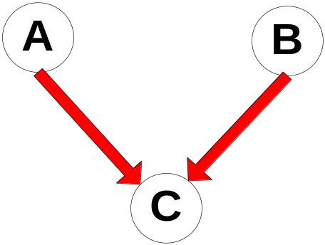
Bayesian Belief Networks
Provides graphical representation of probabilistic relationships among a set of random variables
Consists of:
  A directed acyclic graph (dag)
    Node corresponds to a variable
    Arc corresponds to dependence
    relationship between a pair of variables
  A probability table associating each node to its immediate parent

Slide 25
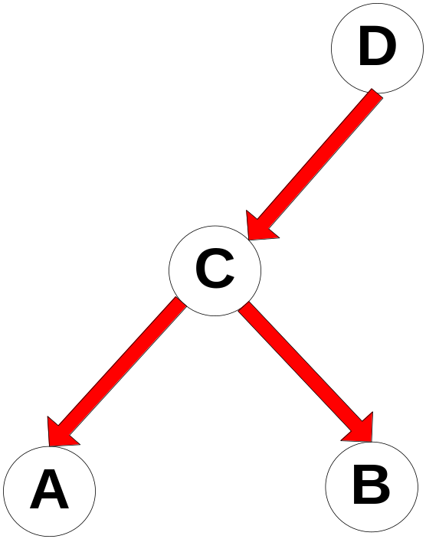
Conditional Independence
D is parent of C
A is child of C
B is descendant of D
D is ancestor of A
A node in a Bayesian network is conditionally independent of all of its nondescendants, if its parents are known

Slide 26
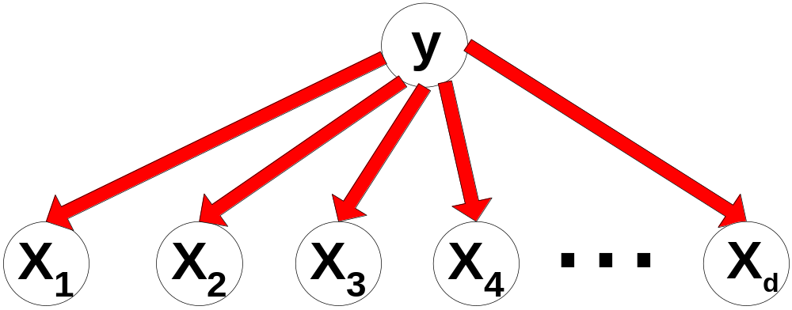
Conditional Independence
Naïve Bayes assumption:

Slide 27

Probability Tables
If X does not have any parents, table contains prior probability P(X)
If X has only one parent (Y), table contains conditional probability P(X|Y)
If X has multiple parents (Y₁, Y₂,…, Y_{k}), table contains conditional probability P(X|Y₁, Y₂,…, Y_{k})

Slide 28
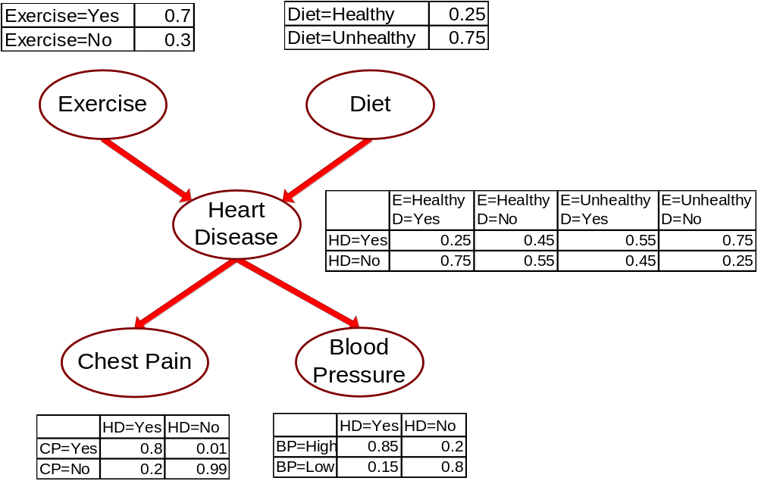
Example of Bayesian Belief Network

Slide 29
Example of Inferencing using BBN
Given: X = (E=No, D=Yes, CP=Yes, BP=High)
  Compute P(HD|E,D,CP,BP)?
P(HD=Yes| E=No,D=Yes) = 0.55
P(CP=Yes| HD=Yes) = 0.8
P(BP=High| HD=Yes) = 0.85
  P(HD=Yes|E=No,D=Yes,CP=Yes,BP=High)
  ∝ 0.55 × 0.8 × 0.85 = 0.374
P(HD=No| E=No,D=Yes) = 0.45
P(CP=Yes| HD=No) = 0.01
P(BP=High| HD=No) = 0.2
  P(HD=No|E=No,D=Yes,CP=Yes,BP=High)
  ∝ 0.45 × 0.01 × 0.2 = 0.0009
Classify X as Yes

